Slide 1
Learning Inventory

Slide 2
What is a learning inventory test?
It shows students how they learn best
Helps teachers understand students learning styles
Helps teachers plan lessons to meet the needs of all students

Slide 3
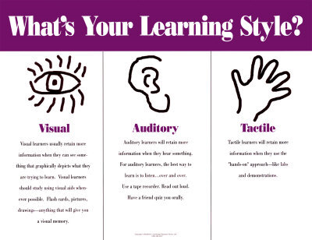
Students have different learning styles and intelligences

Slide 4
Auditory learners
Learn best by listening
Noisier or louder than most children
Difficulty following directions
Has trouble with writing
Hums a lot
Studies best in groups

Slide 5
Visual-spatial learners
Learn best through their eyes
Like to read
Good spellers
Organized
Would rather watch than do

Slide 6
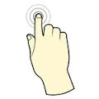
Kinesthetic learners
children learn about the world by touching, feeling, moving, and experiencing.
Like to move around
Like to touch others
Enjoy physical activities
Express their feelings by hugging or hitting

Slide 7
Combination learners
Children who learn best by using all of the learning styles

Slide 8
Why is it important to take a learning preference test?

Slide 9
Students:
For students to find their strengths
Students can find the areas they need to work on the most to improve performance in school
Helps students get organized and learn how to study and do assignments

Slide 10
Teachers:
To learn the best way to teach the class so all students are successful
To find best seating styles and arrangement of classroom
To learn students best learning styles

Slide 11
Parents:
Students are empowered by having their learning style incorporated in the classroom
Parents will understand their child’s learning style and incorporate it at home.
Students, teachers, and parents will all have the same information about the child’s learning style.

Slide 12
How will I take a learning inventory test?

Slide 13
Let me tell you How!!
https://www.youtube.com/watch?v=yksNV6pO5GA

Slide 14
Learning inventory links
Multiple intelligence learning inventory
http://www.edutopia.org/multiple-intelligences-assessment
General learning inventory
http://www.learningreviews.com/Learning-Styles.html

Slide 15
All students will be taking the learning inventory tests in the computer lab. Your teacher will be available to help you get started and answer any questions about completing the inventories
Please print the results and place them in the basket labeled inventories.

Slide 16
Resources
Bixler, B. (2012, June 3). Learning Style Inventory. Retrieved March 22, 2016, from http://www.personal.psu.edu/bxb11/LSI/LSI.htm
Gardner2, H. (2009, August 23). Multiple Intelligences Self-Assessment. Retrieved March 23, 2016, from http://www.edutopia.org/multiple-intelligences-assessment
https://www.youtube.com/watch?v=yksNV6pO5GA

